Slide 1

Computing GCSE CA
Task 1 - A453 – Currency Converter
Kenneth Cajigas

Slide 2

Introduction

Slide 3
Task 1 Requirements
Create a simple currency exchange calculator to convert between four major currencies, Pound sterling, Euro, US Dollar and Japanese Yen.
The system should be able to have exchange rates changed regularly by the user
The user should be able to enter an amount, select the chosen currency for this and the currency into which this should be converted
The figure shown should be displayed to two decimal places, for example to the nearest cent in US Dollars

Slide 4
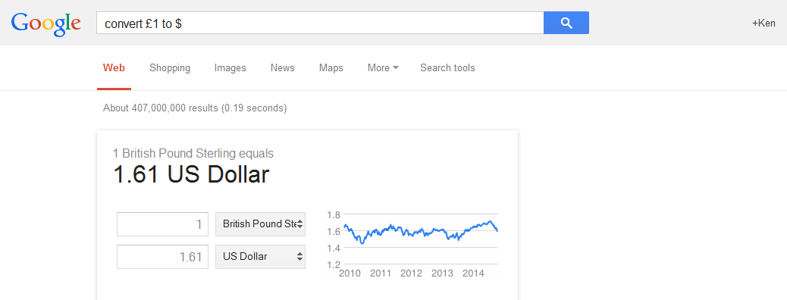
What is a currency converter?
A currency converter is used by many people in our everyday lives.
They can be found at places such as the Bureau du Change shops or even Google can do a simple currency convert
They help us to change our unwanted money from other currencies to the one that we want, and we usually have

Slide 5
Group Discussion
In my group discussion for the currency converter, we noted certain things that were needed in the Currency Converter Code. These included:
The program must be able to read a set of values
The currency rates must be held in a form of list such as a dictionary or a text file
The program must have be to able to handle an input and multiply it by the set rate set
Verification could also be an added feature in the code

Slide 6
The Success Criteria
For a successful code, the currency converter would have to be able to do the following things:
Be able to convert to and from the following rates, Pound Sterling, Euros, Japanese Yen and USD Dollars.
It would also have to be as short and efficient as possible
To be able to be flexible and user friendly
To have a verification check on the user input
Be able to read from a list of rates
These are all things that I will endeavour include in my code and I will be showing the development of each code through versions and how I eventually got to my final code solution in the end.

Slide 7
The algorithms
Pseudocode and Flowchart of the currency converter code

Slide 8
Pseudocode
START
Open currency.txt file
Read each line of the currency.txt file
Split each line with ‘-’
Count=0
For every line in file:
Print ‘Option:’+Count+ split[0]
While True:
Try:
Input what option would you like to choose
Except ValueError:
Print Error! Wrong Input
Else:
continue
While True:
Try:
Input Enter the amount to convert
Except ValueError:
Print Error! Input not a float!
Else:
continue
Calculate the currency conversion:
Do input*split[3] (The currency rate)
Print Result
END

Slide 9
Flowchart
Input ‘How much user would like to convert’
Start
Print ‘Error! You did not enter a valid input!’
Is the input a float?
Open currency.txt file
No
Output ‘Error! Please make sure you enter a float’
No
Is the option between the range
1-11?
Yes
For every line in the file, split with a ‘-’ and print the split[0] out as an option to the user
Yes
For the chosen line, store the value of the currency rate of the chosen option, and multiply by the user input
Input ‘What conversion option would you like to choose to convert?
Input the option the user desires to chose to convert
Output the result of the multiplication and conversion
End

Slide 10
The code development
I will only annotate code only when there are differences in the code

Slide 11
Development log of the different versions for the currency converter code
Version 1:
Version 1 used the very simple dictionary function where all the conversion rates were stored in each dictionary for each currency to convert from and to.
Version 2:
Version 2 was much different and this time opened a file and was able to read, identify and separate the values to the conversions.
Version 3:
Version 3 was a much more efficient and a shorter way of producing a code and outputting results, making more use of the .split function
Version 4:
Finalized code, with added looping if values entered were invalid.

Slide 12
The code version 1
My first version of the code used the dictionary function
I found that it was simple to do and easy to manage the currencies in a dictionary
I was able to name the dictionary for each of the currency rate names and to be able to put the other currencies in it to convert to it
The user had to input a currency to ‘convert from’ which would determine what dictionary the code would be using
There were also multiple ‘if’ statements that I used in my version of the code
These if statements enabled me to have different currency signs for each and to determine which dictionary to get the conversion rates from

Slide 13
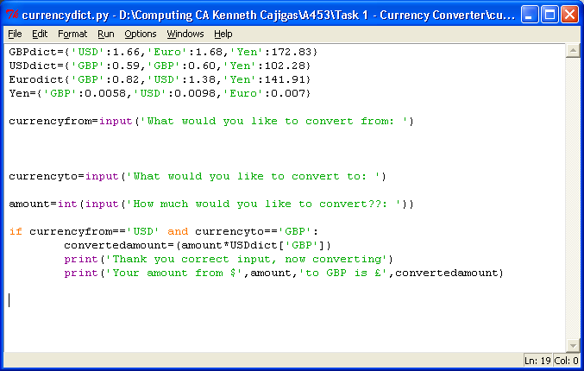
The code version 1 - Overview

Slide 14
The code version 1
All the currency rates would be kept here
The inputs will all determine which ‘if’ statement
For example, if the currencyfrom input is equal to ‘USD’ and currencyto is equal to ‘GBP’ then the code will do the conversions by multiplying the number in the dictionary by the amount inputted by the user

Slide 15
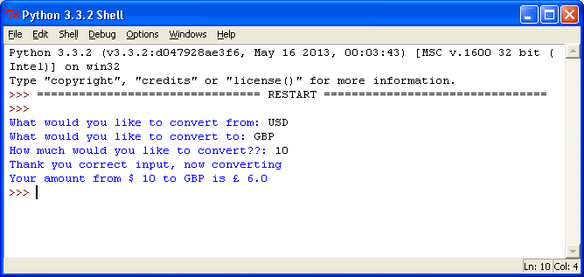
The code version 1 - results
The code allowed me to have different currency symbols when printing the results of the conversion
It also told the user that it was a correct input and printed out the results

Slide 16
The code version 1 - feedback
I received some positive feedback for my first solution towards the code.
My code was able to convert between any two currencies
It was also simple to manage the currency rates too
However I thought that I can do more in the next version of my code by making it be able to open a file
It should also have different ways of calculating the output instead of keeping the figures in a dictionary.

Slide 17
The code version 2
The code here was able to take in what the person would like to convert from and to, giving the appropriate figure at the end
However I found that it was quite complicated to manage and to write each ‘if’ statement separately. This also applied to my next version of the currency converter code.
Therefore I decided to make the code be able to open a file with all the currency rates inside of it
There were still the custom currency sign for each calculation depending on the currency to and from the user inputs

Slide 18
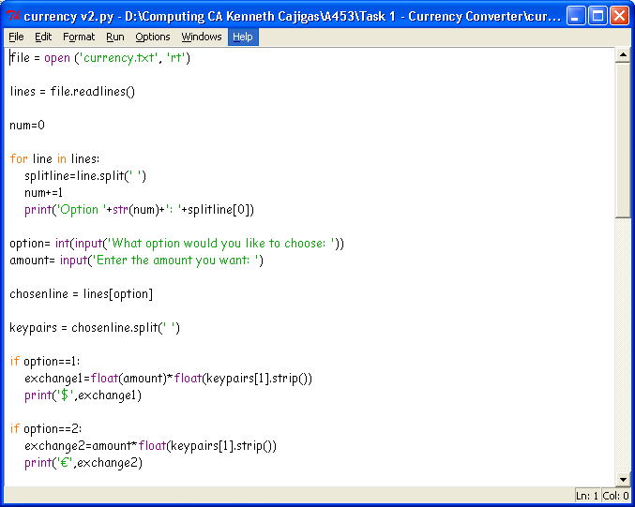
The code version 2 - Overview

Slide 19
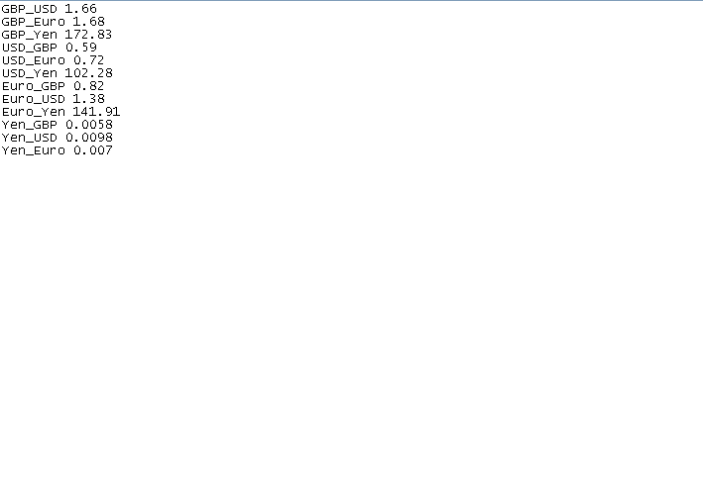
The code version 2 – Text File Overview
The currency rates to convert to another currency is set here. For example Pounds to Dollars will be shown here as ‘GBP_USD’. The figure and the name of the currency rate conversion will be separated in the code with a space. This will be shown as line.split(‘ ‘) in the code.

Slide 20
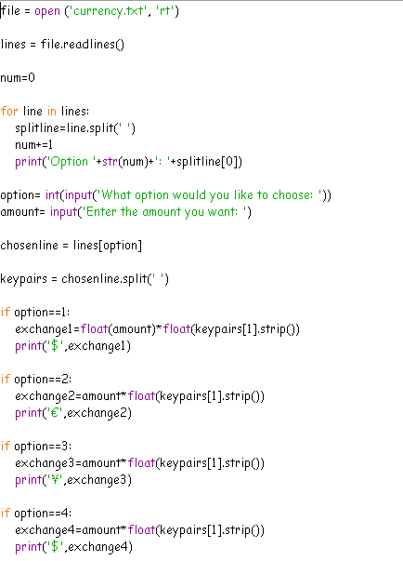
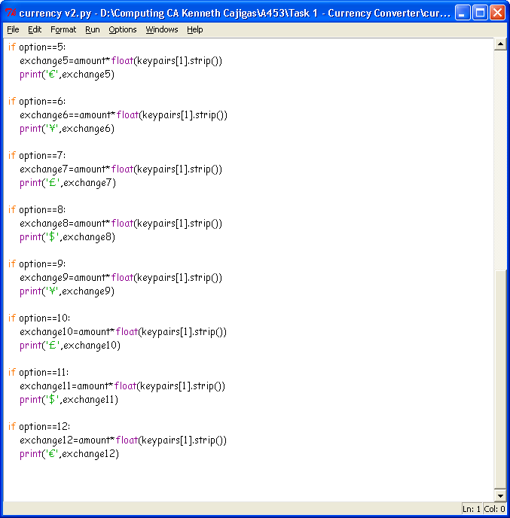
The code version 2 - Full
This will loop until all the lines are printed and prints each line with an option
This will allow the user to input an option and the amount
The chosen line will be defined by the input
From here, it will find what option is equivalent to the input and do the multiplication. It will also add the currency sign too.

Slide 21
The code version 2 - Feedback
The version 2 of the code allowed the option inputted to print out the results for each conversion
The code also allowed for each option in the ‘if’ statements to have a different currency sign for each conversion put
However there were also problems with the code…..
The code didn’t have any error messages
The code wasn’t able to have a verification check
It was also inefficient and was way too long to write each if statement separately
The code wasn’t able to determine between an integer and a string
Therefore a version 3 was now needed………

Slide 22
The code version 3
The new version of the code was much shorter and allowed me to do more edits to the code easily instead of having to continually edit each of the lines
The new code also allowed me to learn more about split lines and their flexibility to do many more things
It was also able to do much more, but in a more smaller, compressed version of the code

Slide 23
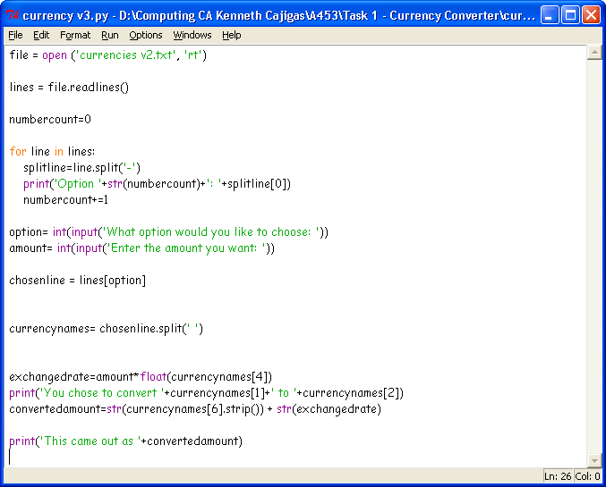
The code version 3 - Overview

Slide 24
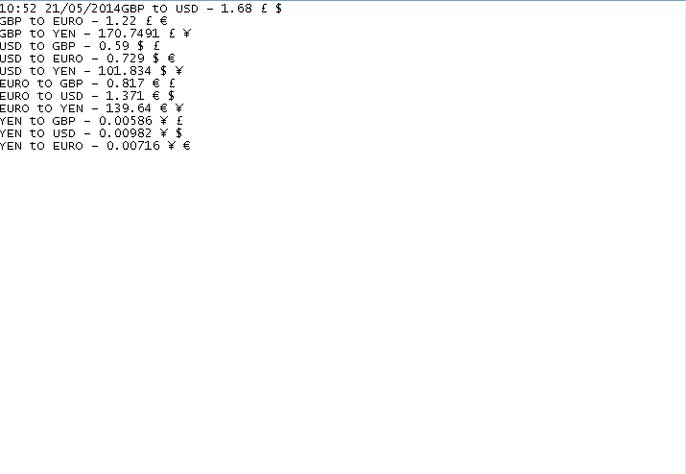
The code 3 – Text File
The currency signs were now also added to the new version of the next file. They were separated with a space, and the variable used in V3 of the code was called ‘currencynames’
The currency rates to convert to another currency is set here. For example Pounds to Dollars will be shown here as ‘GBP to USD’. You may notice that now in this text file there are now spaces which may confuse the code, however I have solved it by instead separating the figure and the conversion name with a dash (‘-’). I was also able to separate the currency sign with multiple .split variables as seen in the next slide.

Slide 25
The code version 3 - Full
Loops until all lines are printed out. Will be splitting the lines with a ‘-’
Allows the user to chose options and input an amount
This will print the amount * exchanged rate and will print the results. This bit will also print the currency sign that can be seen in the text file along with the results.

Slide 26
The code version 3 - feedback
The new code that I had produced was almost perfected with only a few minor changes that I had to do
These changes included things such as:
Understandable and variables with an actual meaning towards the name
Be able to have a verification check into my code
To allow the user to easily change the conversion rate if needed to the file for ease
To be able to have the code determine whether an input is valid or invalid (point 2)
To have an option to change the conversion file via the code in Python (point 3)
Version 4 hopefully should have addressed most of these issues

Slide 27
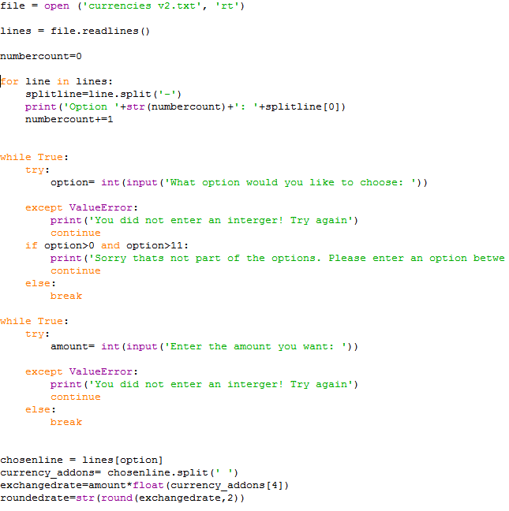
The code version 4 - Overview

Slide 28
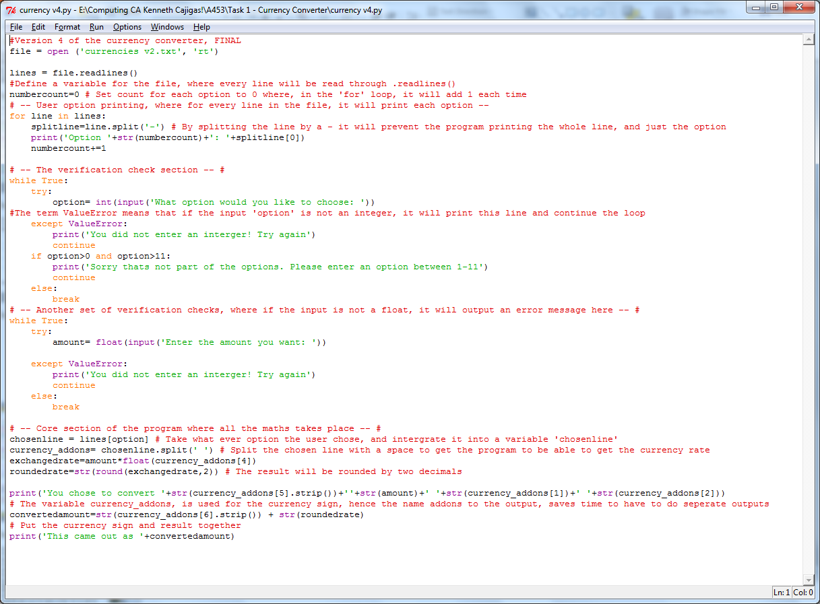
Full code
Allows the user to chose options and input an amount and an option. The use of ‘while True’ allows the code to loop until it is satisfied with the user input
Except ValueError means, if the input entered is not an integer.
Although it may look complicated, this print bit allows the code to show the use of variables.

Slide 29
The code version 4 - Feedback
My final version of the code was very simple and allowed me to do many changes as I pleased. It was working very well.
The code was finally able to loop, thanks to research on how to do a while loop until the input entered satisfied the conditions.
The code was able to have the currency sign integrated from the text file into the actual code, without me having to do repetition like in Version 2 of my code, where it was repetition, with only the difference being the currency sign outputted
It was also able round the results printed into two decimal places

Slide 30
The test plan
I am going to be testing my currency converter code by entering multiple inputs
Hopefully the code should be able to recognize the input and it should output its currency sign and the conversion result
I will try my best to break it, and if there are any errors, fix it.

Slide 31
Test plan table
Test number Valid/Invalid | Input | Data | Expected outcome
1: Valid | Option ‘0’ 96 | Integer Integer | Should give out the result $164.281
2: Invalid | abcdefgjik | String | Should fail with a message ‘Letters entered’ Should continue looping
3: Valid | Option ‘6’ 498.12 | Integer Float | Should output 54681.12 Yen, with rounded result
4: Invalid | Option ‘100’ | Integer | Should output ‘Sorry that’s not an option’
5: Invalid | Option ‘1265’ | Integer | Should output ‘Sorry that’s not an option’
6: Valid | Option ‘2’ 6.421 | Integer Float | Should output 8.19 Euros

Slide 32
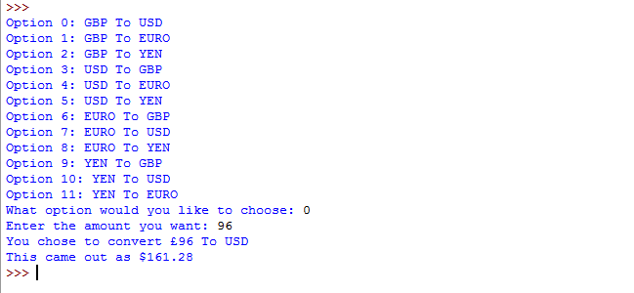
Results:
1: Valid | Option 0 96 | Numbers | Should give out the result $164.281

Slide 33
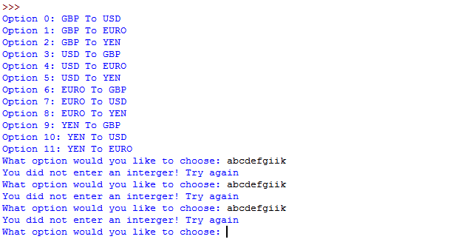
Results:
2: Invalid | abcdefgjik | Letters | Should fail with a message ‘Letters entered’ Should continue looping

Slide 34
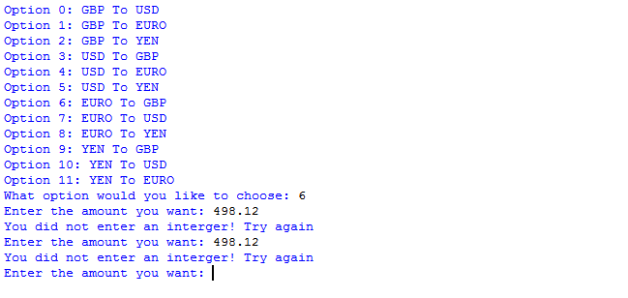
Results:
3: Valid | Option 6 498.12 | Numbers | Should output 54681.12 Yen

Slide 35
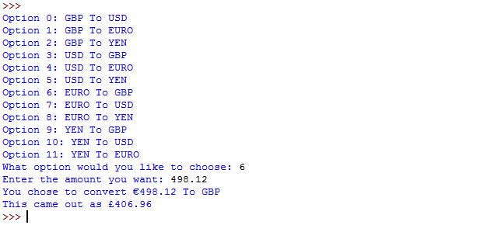
Test 3 proved the code was not working properly, however this was easily fixed by changing this line, from ‘int’ to ‘float’

Slide 36
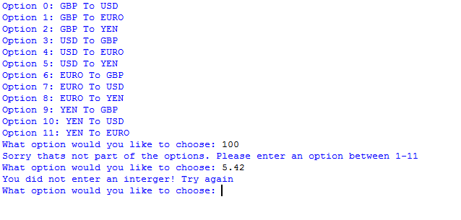
Results:
4: Invalid | Option 100 5.42 | Numbers | Should output ‘Sorry that’s not an option’

Slide 37
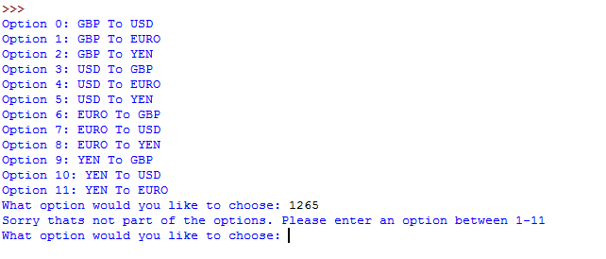
Results:
5: Invalid | 1265 | Numbers | Should output ‘Sorry that’s not an option’

Slide 38
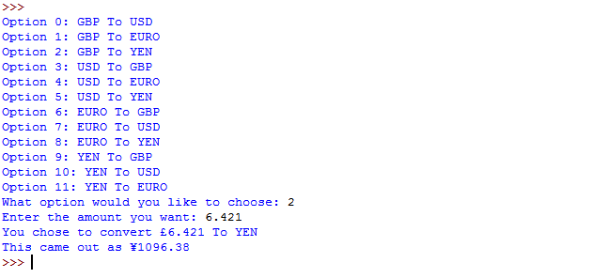
Results:
6: Valid | Option 2 6.421 | Numbers | Should output 8.19 Euros

Slide 39
In the success criteria that has been set, my code meets:
My code was able to meet all of the success criteria's that were set before developing the code. These were:
Be able to convert to and from the following rates, Pound Sterling, Euros, Japanese Yen and USD Dollars.
It would also have to be as short and efficient as possible
To be able to be flexible and user friendly
To have a verification check on the user input
Be able to read from a list of rates

Slide 40
ending
Conclusion, Evaluation (Of code)

Slide 41
Evaluation
I found that the code was working fully and passed all the tests that I did
The code however was very long and I could have shortened it to add efficiency to the code
Although it was longer then usual, it was able to know when an input was valid or invalid and it also gave a message when the input was accepted.
If I could spend longer on the code, I would look for flaws in my code and fix them.
Also adding a feature where the user would be able to change the rates in the program would be useful also.

Slide 42
Conclusion
Overall I found that making the Currency converter code was challenging.
I was able to use a range of functions during the development of my code, from a dictionary to a text file.
However I found it quite challenging when it came to understanding how the Dictionary function worked
If I could redo the code, I would add an option were the user would be able to change the currency rates through the code if needed.
Notes:
Done!

